Slide 1
Searching in a Graph
CS 5010 Program Design Paradigms “Bootcamp”
Lesson 8.5
© Mitchell Wand, 2012-2016
This work is licensed under a Creative Commons Attribution-NonCommercial 4.0 International License.
TexPoint fonts used in EMF.
Read the TexPoint manual before you delete this box.: AAA

Slide 2
Introduction
Many problems in computer science involve directed graphs.
General recursion is an essential tool for computing on graphs.
In this lesson we will design a program for an important problem on graphs, using general recursion
The algorithm we will develop has many other applications.

Slide 3
Learning Objectives
At the end of this lesson you should be able to:
explain what a directed graph is, and what it means for one node to be reachable from another
explain what a closure problem is
explain the worklist algorithm
write similar programs for searching in graphs.

Slide 4
What's a graph?
You should be familiar with the notion of a graph from your previous courses.
A graph consists of some nodes and some edges.
We will be dealing with directed graphs, in which each edge has a direction. We will indicate the direction with an arrow.

Slide 5
A Graph
nodes: A, B, C, etc.
edges:
(A,B), (A,C),(A,D), etc.
A
B
C
D
E
F
G

Slide 6
successors of a node
The successors of a node are the nodes that it can get to by following one edge.
(successors A) = {B,C,D}
(successors D) = {C,F}
A
B
C
D
E
F
G

Slide 7
all-successors of a set of nodes
A
all-successors of a set of nodes are all the successors of any of the nodes in the set
(all-successors {}) = {}
(all-successors {A,D})
= {B,C,D,F}
B
C
D
E
F
G

Slide 8
Paths in a Graph
A path is a sequence of nodes that are connected by edges. Notice that the node A by itself is a path, since there are no edges to check. On the other hand, (A,A) is not a path, since there is no edge from A to itself.
A
B
C
D
E
F
paths:
(A,C,E)
(B,C,E,G)
(A,D,C,E)
(A)
non-paths:
(D, A)
(A,C,G)
(A,C,D,E)
(A,A)
G

Slide 9
Cycles
This graph has a cycle: a path from the node B to itself. Graphs without cycles are said to be acyclic.
For this lesson, our graphs are allowed to have cycles.
A
B
C
D
E
F
G

Slide 10
Reachability
One node is reachable from another if there is a path from the one node to the other.
A
B
C
D
Nodes reachable from D:
{B,C,D,E,F,G}
Not reachable:
{A}
E
F
G
D is reachable from itself by a path of length 0, but not by any other path

Slide 11
Another classic application of general recursion
reachables :
Graph SetOfNode -> SetOfNode
GIVEN: a graph and a set of nodes
RETURNS: the set of nodes that is reachable from the given set of nodes

Slide 12
Definition
A node t is reachable from a node s iff either
t = s
there is some node s' such that
s' is a successor of s
t is reachable from s'

Slide 13
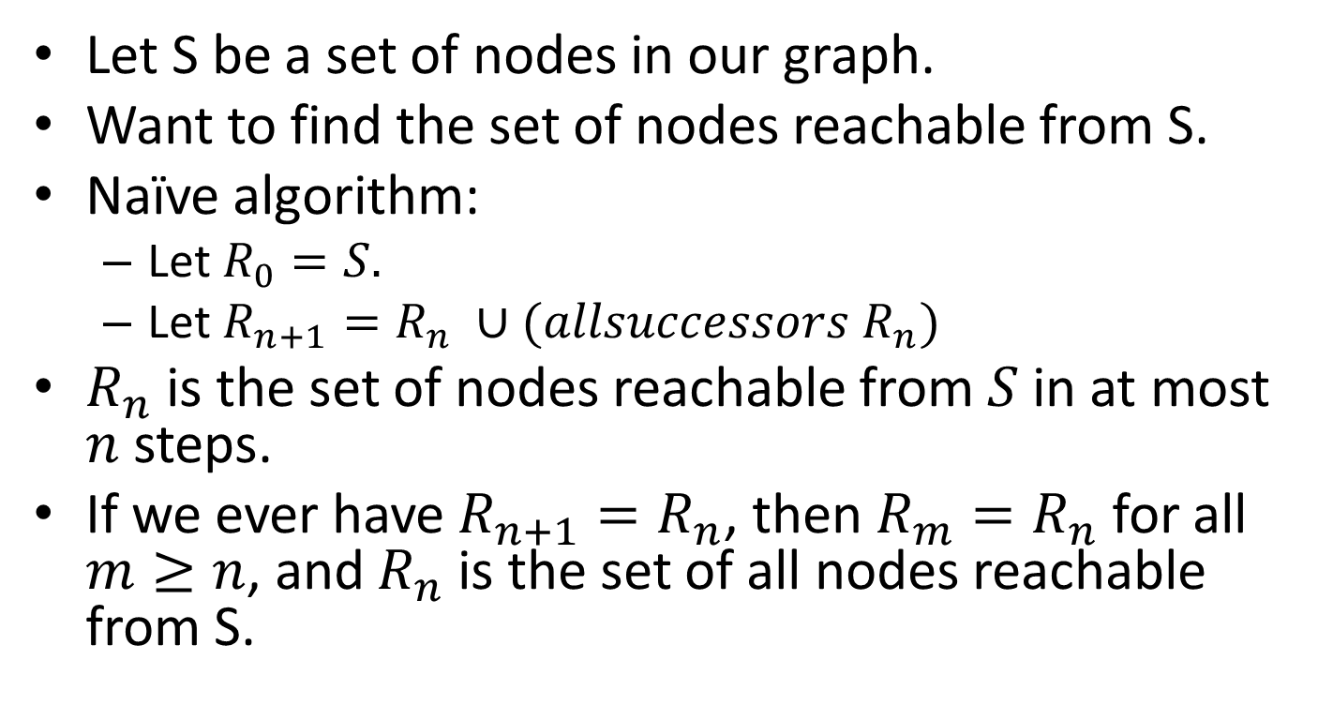
Enumerating the elements
Let S be a set of nodes in our graph.
Want to find the set of nodes reachable from S.
Naïve algorithm:
Let $R_{0}=S.$
Let $R_{n+1}=R_{n} ∪(allsuccessors R_{n})$
$R_{n}$is the set of nodes reachable from $S$ in at most $n$ steps.
If we ever have $R_{n+1}=R_{n}$, then $R_{m}=R_{n}$ for all $m≥n$, and $R_{n}$ is the set of all nodes reachable from S.

Slide 14





Example
A
A
A
A
B
C
D
B
C
D
B
C
D
B
C
D
E
F
E
F
E
F
E
F
G
G
G
G
$$R_{0}=\{D\}$$
$$R_{1}=\{D,C,F\}$$
$$R_{2}=\{D,C,F,E,G\}$$
$$R_{3}=\{D,C,F,E,G,B\}$$
$$R_{4}=\{D,C,F,E,G,B\}$$
$$\text{therefore} R_{n}=\left\{D,C,F,E,G,B\right\} \text{for} n≥4$$

Slide 15
Closure problems
This is called a "closure problem": we want to find the smallest set R which contains our starting set S and which is closed under some operation
In this case, we want to find the smallest set that contains our starting set of nodes, and which is closed under all-successors.

Slide 16
Assumptions
We assume we've got data definitions for Node and Graph, and functions
node=? : Node Node -> Boolean
successors :
Node Graph -> SetOfNode
all-successors :
SetOfNode Graph -> SetOfNode
We also assume that our graph is finite.

Slide 17
Initial Solution
;; reachables: SetOfNode Graph -> SetOfNode
;; GIVEN: A set of nodes in a graph
;; RETURNS: the set of nodes reachable from the starting nodes
;; STRATEGY: recur on (nodes U their immediate successors)
;; HALTING MEASURE:
;; # of nodes in the graph that are NOT in the set 'nodes'.
(define (reachables nodes graph)
(local
((define candidates (all-successors nodes graph)))
(cond
[(subset? candidates nodes) nodes]
[else (reachables
(set-union candidates nodes)
graph)])))
if 'nodes' is closed under all-successors, then we're done
Otherwise, add the candidates to the nodes, and try again

Slide 18
Problem with this algorithm
We keep looking at the same nodes over and over again:
we always say (all-successors nodes), but we've seen most of those nodes before.

Slide 19
A Better Idea: keep track of which nodes are new
S
only need to explore nodes in this region– all others are accounted for.

Slide 20
Do this with an extra argument and an invariant
S
newest = the most recently added elements of 'nodes'
nodes

Slide 21
Version with invariant
;; reachables1 : SetOfNode SetOfNode Graph
;; GIVEN: two sets of nodes, 'nodes' and 'newest' in a graph
;; WHERE: newest is a subset of nodes
;; AND: newest is the most recently added set of nodes
;; RETURNS: the set of nodes reachable from 'nodes'.
;; STRATEGY: recur on successors of newest that are not already in nodes;
;; halt when no more successors
;; HALTING MEASURE:
;; # of nodes in the graph that are NOT in the set 'nodes'.
(define (reachables1 nodes newest graph)
(local
((define candidates (set-diff
(all-successors newest graph)
nodes)))
(cond
[(empty? candidates) nodes]
[else (reachables1
(append candidates nodes)
candidates
graph)])))
Since candidates is disjoint
from nodes, we can replace the set-union with append.

Slide 22
Initializing the invariant
;; we initialize newest to nodes since
;; initially all the nodes are new.
;; STRATEGY: Call more general function
(define (reachables nodes graph)
(reachables1 nodes nodes graph))

Slide 23
This is called the "worklist" algorithm
It is used in many applications
in compiler analysis
in AI (theorem proving, etc.)

Slide 24
You could use this to define path?
;; path? : Graph Node Node -> Boolean
;; GIVEN: a graph and a source and a
;; target node in the graph
;; RETURNS: true iff there is a path in g
;; from src to tgt
;; STRATEGY: call more general function
(define (path? graph src tgt)
(member tgt (reachables (list src) graph)))

Slide 25
But for that, you don't need to build the whole set
(define (path? graph src tgt)
(local
((define (reachable-from? newest nodes)
;; RETURNS: true iff there is a path from src to tgt in graph
;; INVARIANT: newest is a subset of nodes
;; AND:
;; (there is a path from src to tgt in graph)
;; iff (there is a path from some node in newest to tgt)
;; STRATEGY: recur on successors of newest; halt when tgt is found.
;; HALTING MEASURE: the number of graph nodes _not_ in 'nodes'
(cond
[(member tgt newest) true]
[else (local
((define candidates (set-diff
(all-successors newest graph)
nodes)))
(cond
[(empty? candidates) false]
[else (reachable-from?
candidates
(append candidates nodes))]))])))
(reachable-from? (list src) (list src))))
Look carefully at this invariant.
Just watch for tgt to show up in newest
Why is the invariant true again at this call?
Can you check to see that the invariant is true at this call?

Slide 26
Another topic: changing the data representation
;; reachables: SetOfNode Graph -> SetOfNode
(define (reachables nodes graph)
(local
((define candidates (all-successors nodes graph)))
(cond
[(subset? candidates nodes) nodes]
[else (reachables
(set-union candidates nodes)
graph)])))
Notice that the only thing we do with graph is to pass it to all-successors.

Slide 27
So let’s pass in the graph’s all-successors function
;; reachables: SetOfNode (SetOfNode -> SetOfNode)
;; -> SetOfNode
(define (reachables nodes all-successors-fn)
(local
((define candidates (all-successors-fn nodes)))
(cond
[(subset? candidates nodes) nodes]
[else (reachables
(set-union candidates nodes)
all-successors-fn)])))

Slide 28
How do you build an all-successors-fn?
;; You could do it from a data structure:
;; Graph -> (SetOfNode -> SetOfNode)
(define (make-all-successors-fn g)
(lambda (nodes)
(all-successors nodes g)))

Slide 29
Or you could avoid building the data structure entirely
Just define a successors function from scratch, and then define all-successors using a HOF.
Good thing to do if your graph is very large– e.g. Rubik’s cube.

Slide 30
Example of an “implicit graph”
;; Int -> SetOfInt
;; GIVEN: an integer
;; RETURNS: the list of its successors in the implicit graph.
;; For this graph, this is always a set (no repetitions)
(define (successors1 n)
(if (<= n 0)
empty
(local
((define n1 (quotient n 3)))
(list n1 (+ n1 5)))))
A portion of this graph….
6
2
7
From Examples/08-5a-implicit-graphs.rkt
0
5
1

Slide 31
;; all-successors1 : SetOfInt -> SetOfInt
;; GIVEN: A set of nodes
;; RETURNS: the set of all their successors in our implicit graph
;; STRATEGY: Use HOFs map, then unionall.
(define (all-successors1 ns)
(unionall (map successors1 ns)))
Here’s a function you could pass to reachables.

Slide 32
Summary
We've applied General Recursion to an important problem: graph reachability
We considered the functions we needed to write on graphs in order to choose our representation(s).
We used list abstractions to make our program easier to write

Slide 33
Learning Objectives
You should now be able to:
explain what a directed graph is, and what it means for one node to be reachable from another
explain how the function for reachability works.
explain what a closure problem is
explain the worklist algorithm
write similar programs for searching in graphs.

Slide 34
Next Steps
Study 08-5-reachability.rkt and 08-5a-implicit-graphs.rkt in the Examples folder.
If you have questions about this lesson, ask them on the Discussion Board
Do Guided Practice 8.4

